Slide 1
Webinar: Ambulatory and OP Diagnostic Re-Activation
May 29, 2020

Slide 2
Panelists
Re-Activation Overview
Patrick Towne, MD | President, RMG
Patient Screening
Maria Hamakiotis | Associate Chief Nurse Executive & Director of Professional Practice, NMG
Facilities
Jeff Good | Vice President, Security
Colleen Schmiege | Vice President, Operations
PPE and Infection Prevention
Gina Dolgin | Director, Infection Prevention
Mental Health and Well-Being
Gaurava Agarwal, MD | Director of Physician Well-Being, NMG

Slide 3
Re-Activation: Safety Measures in the Ambulatory Clinic & Outpatient Diagnostic Settings
Patrick Towne, MD
President, RMG

Slide 4
Screening
Maria Hamakiotis
Associate Chief Nurse Executive & Director, Ambulatory Operations

Slide 5
Screening Patients at Multiple Contact Points to Ensure Safety
Scheduling
ILI symptoms screening (current/last 40 days)
COVID+ in the last 40 days
Telehealth vs. In-person
Pre-Procedural testing
Reinforce universal masking requirements on campus
1
Pre-visit screen
2
Review clinic schedules 24-48hrs prior to visit
Assess appropriateness of in-person visits
ILI symptom screeening
COVID+ in the last 40 days
COVID Flag
Clinical Clearance Guidelines
4
Check-in
ILI symptom screening
COVID+ in the last 40 days
COVID flag
If positive screening, activate COVID workflows based on the ambulatory clinic algorithm
Arrival to campus
3
Universal masking
Temperature screening
ILI symptoms screening
COVID+ in the last 40 days
If symptomatic, warm handoff to the clinic team (site dependant)
Notes:
As we have already emphasized, employee and patient safety is the core of all reactivation activities.
One of our main goals is to limit the likelihood of a symptomatic patient entering our NM Facilities and putting both patients and employees at risk.
I would like to highlight the 4 points of screening that have been implemented to minimize the likelihood of this occurring, and if a symptomatic patient does need to be seen, it is done in an organized and safe manner.
Scheduling:
When a patient calls to schedule an appointment, considered as the first point of screening, the call agents screen every single patient for:
ILIL symptoms, both current symptoms and within the last 40 days as well as a
Diagnosis of COVID+ within the last 40 days
Based on their answers, patients are scheduled for a telehealth visit with communication to the clinic about the relevant clinical history
It’s important to note that patient preference will be used to select visit type, either tele health or in person, but a symptomatic patient will be defaulted to telehealth, and the clinical team evaluates the appropriateness for this visit type.
June 15 the call center will default to in-person visits, instead of tele-health, but patient preference will still be respected
The call center team also assists patients with obtaining pre-procedural COVID testing following the ambulatory scheduling protocols
Lastly, during the scheduling process, our agents remind patients of the requirement of universal masking while on NM facilities.
Pre-Visit Screening:
The second point of screening is during the newly added process of scrubbing schedules 24-48hrs prior to an appointment to assess for the appropriateness of the visit. This workflow enlists the help from both clinical and non clinical team members within each clinic and provides the team the opportunity to review all schedules and make any necessary changes such as changing the visit type, or even rescheduling if appropriate.
All patients scheduled for an in-person visit are called and we assess them for:
ILI symptoms and a diagnosis of COVID+ within the last 40days
The teams review the chart to see if there is a COVID Flag, or whether one needs to be added
It’s at this time that the clinical teams in the practice also assess the patients with a COVID flag and determine if their current COVID status can be cleared prior to the planned 40days either using Clinical Clearance Algorithms
Arrival on Campus
The third point of patient screening is upon arrival to an NM Facility where all patients are:
Provided with a mask and explained the importance of wearing a mask throughout the duration of their visit
They have their temperature taken
Are screened for ILI symptoms
And a diagnosis of COVID+
And if they are found to be symptomatic, there is a warm handoff to the clinics and activation of the COVID workflows which may vary based on location of the practice
Check-In
The fourth point of patient screening is at the time of Check-in to the clinic where the PSR team will once again screen for:
ILIL symptoms, both current symptoms and within the last 40 days as well as a
Diagnosis of COVID+ within the last 40 days
The PSR will review the chart to see if there is a COVID Flag, or whether one needs to be added
If the patient screens positive, the team activates the COVID workflows as described on the Ambulatory clinic algorithm which includes details about PPE use, rooming, even the use of the Clinical Clearance Algorithms if necessary.

Slide 6
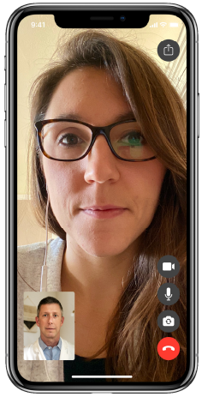
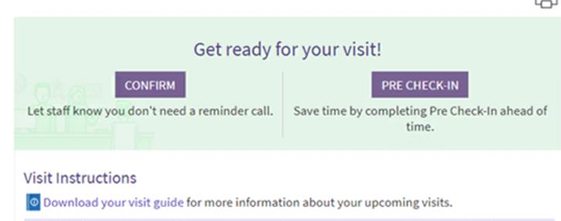
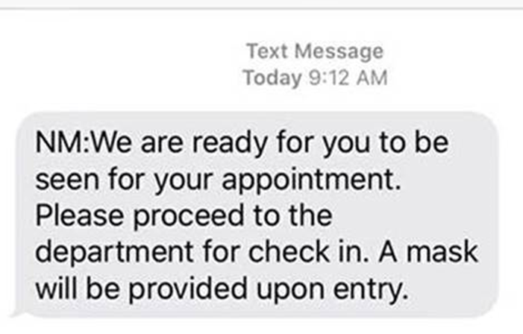
Telehealth and Technology to Support Safety
Telehealth visits are a great way to safely evaluate patients with ILI symptoms or to treat high risk patients without having them come into the office. Doximity is NM’s primary video and audio telehealth visit solution
Visit Guides are being sent to patients in advance of all visits to provide instructions for both in-person and telehealth visits
With eCheck-In via MyChart patients can update their demographics, verify insurance, and pay copays before they arrive at NM
Patient Messaging sent directly from Epic allows you to notify a patient to proceed to the department for check-in, update on clinic delays, or send a message to a patient’s designated ride that patient is ready for pick up
Notes:
Telehealth is not new to Ambulatory care Areas, but we have made important advances in the use of technology to ensure safety and when possible, minimize unnecessary contact.
As already mentioned, we have significantly expanded the use of televisits when appropriate and DOXIMITY has been the primary solution to do this efficiently and safely.
Patient Messaging will go live on June 1st and will allow for a …

Slide 7
Facilities
Jeff Good | Vice President, Security
Colleen Schmiege | Vice President, Operations

Slide 8
Facilities
Staff and Public Screening Processes
Hand Sanitizer Stations
Universal Masking
Temperature and Symptom Screening
Cleaning Protocols
Signage package development and placement recommendations
Clinical –
Increased frequency of cleaning of high touch areas and public spaces
Self-cleaning options
Parking / Public Transportation
Elevator Management
Non-Clinical -
Office space capacity
Conference Rooms
Public areas, including cafeterias/retail
NM Garage daily parking evaluation
Employee commuting strategy and Shuttle Bus impact
Guidelines for max capacity
Operational flow review
Waiting Rooms, Breakrooms, Shared workspaces
Building Lobbies
Signage
Physical Distancing Accommodations
Public Spaces
Operational Flow
Long term plan
Additional Areas of Review:
Breakroom Alternatives
Air Quality
Fitness Centers / Childcare Centers

Slide 9
Facilities
Physical Distancing Guidelines
Updated Cleaning Protocols
In partnership with Infection Prevention updated cleaning protocols have been developed. These protocols target:​
High-touch areas​
Increased frequency​
Guidelines that empower end users to clean as they feel is needed
Supply Chain has been engaged to ensure NM is able to provide appropriate cleaning products to clinics and administrative departments as needed
Information for end users has been posted on NMI and is part of the Facilities Readiness package
Elevator occupancy has been reduced to allow for physical distancing​
Signs posted include:​
Reminder that elevators have a maximum occupancy to enable physical distancing​
Clings on the floor indicating where to stand in the elevator car​
Property Ops/Facilities will continue monitoring elevator flow and triage issues as needed
Waiting Rooms
Space seats 6‘ apart; place some seats close for caregiver and patient to sit adjacent; continue to provide a variety of seating (standard chairs and bariatric or love seat) depending on patient type and complement.
Identify alternate waiting spaces (e.g. exam rooms) in the event of overflow
Check in / Check Out Desks
Install Plexiglas shields
Shared workspaces
If 6’ distancing is not feasible, partner with IP to identify appropriate PPE usage
Breakrooms
Identify alternate breakroom space to accommodate staff needs
Public areas, including cafeterias/restaurants
Space furniture, including tables and seats 6 feet apart minimum
Create lines for waiting/queueing at 6’ intervals using approved floor clings (near entrances, elevators, restrooms, concierge desks, vending, ATMs, escalators, etc.)
Elevator Management

Slide 10
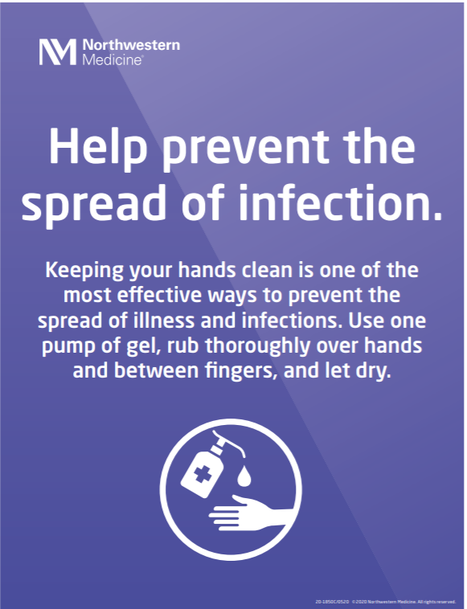
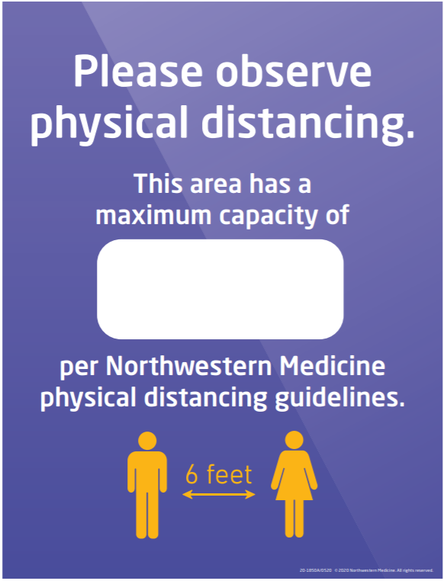
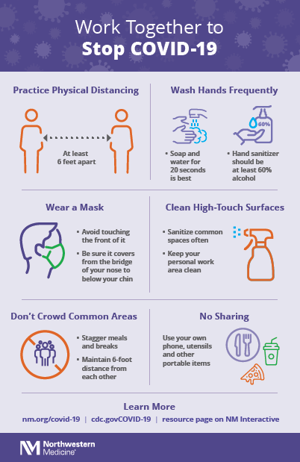
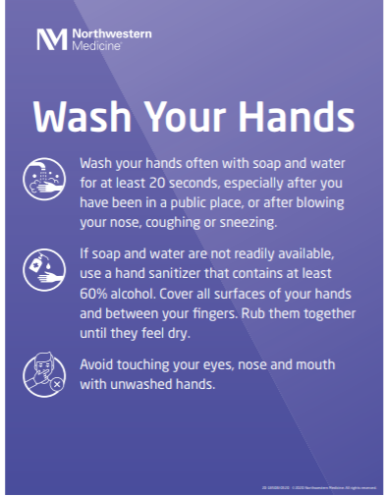
Signage Package Sample

Slide 11
PPE and Infection Prevention
Gina Dolgin
Director, Infection Prevention

Slide 12
Ambulatory and OP Diagnostic Reactivation
Top priority is the safety of all NM employees and the safety of our patients
Safety measures put in place:
Universal masking of all employees and visitors
Employee and visitor temperature and symptom screening
Visitor restrictions
PPE Resources: PPE Grid, Guidelines and Video
Signage and other materials to support distancing, including space evaluation
Reactivation Playbooks

Slide 13
Universal Masking
Why?
Universal Masking helps to keep everyone safe by minimizing risks of exposures and transmissions
CDC recommends masking where physical distancing may be difficult to maintain
IDPH ordered masks or face coverings to be worn in Illinois when leaving the home and maintaining 6 feet of physical distancing is not possible
Who?
All employees at NM; including staff involved in both direct patient care and non-patient care related activities
Patients & Visitors
All NM Facilities; including hospitals, ambulatory sites, administrative areas and all NM buildings
Masks should be worn in all shared spaces such as hallways, multi-stalled bathrooms, breakrooms and elevators
A mask does not need to be worn in non-clinical spaces where physical distancing can be maintained, such as eating in a designated area at least six feet from others or in a private office
Where?
Requires everyone to wear an NM-issued procedure mask to cover your mouth and nose when inside any NM facility. Cloth or homemade masks are not considered PPE
Masks can be re-used until they are damaged, soiled or compromised
Only remove your mask when you can consistently and reliably practice physical distancing
All patients and visitors will be offered an NM-issue mask, which should be worn at all times. If preferred, they may cover their own mask with an NM-provided mask
What?

Slide 14
What PPE Do I Need?
“Usual COVID PPE"=Procedural mask, gown, gloves, eye protection
Patient exam / Vital signs
N95 COVID PPE= N95, gown, gloves, eye protection
Phlebotomy
Swabbing For Step/flu/COVID
Imaging procedure
Nebulizers
Endoscopic procedures
Aerosol Generating Procedure (AGP)
Pulmonary Function Test
Please refer to our PPE Grid on NMI to see what PPE to wear based on job performed or location
Please refer to NMI for a full list of Aerosol Generating Procedures

Slide 15
Exposures
What is an Exposure?
Contact within six feet of a positive case during the exposure period for fifteen minutes or greater without either person wearing a mask
-OR-
Contact within six feet of a positive case during the exposure period for fifteen minutes or greater where the positive case was not wearing a cloth face covering or face mask and HCP is not wearing eye protection
-OR-
Staff who performed an aerosol-generating procedure without wearing an N95 respirator and eye protection on the positive case
What is the Exposure Management Process?
A patient or employee is identified as a laboratory-confirmed COVID-19 case
Infection Prevention performs a review to determine if an exposure occurred
A notification is sent to the manager/director providing specific instructions on next steps
All employees who may have been exposed will be notified by their manager/director and need to complete an EIR and self monitoring
Employees can continue to work after a potential exposure as long as they are not symptomatic
Employees that are part of an exposure should call the COVID hotline for testing after day 4 of exposure even if asymptomatic

Slide 16
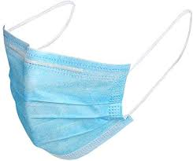
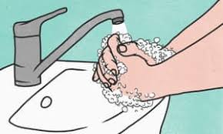
How Do I Stay Safe?
Keys to staying safe and protected
Follow the universal masking requirement
Use the correct PPE for the task being performed
Don and doff PPE correctly
Perform frequent hand hygiene
Follow proper cleaning practices
Implement physical distancing
Don’t come to work sick

Slide 17
Mental Health and Well-Being
Gaurava Agarwal, MD
Director of Physician Well-Being, NMG

Slide 18
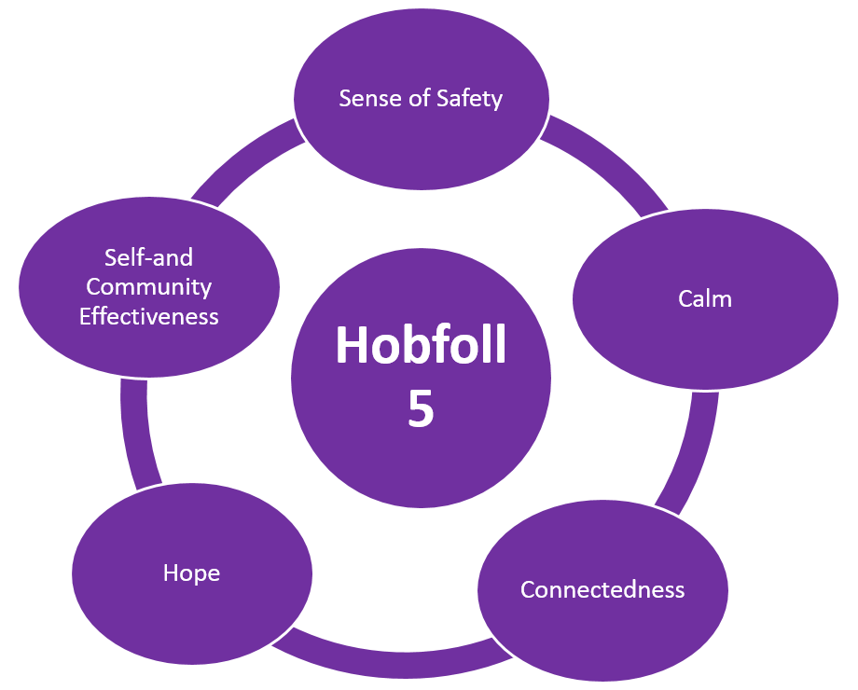
Caring for ourselves and Each Other
Hobfoll 5: An evidence-informed set of principles that are helpful in facilitating behavioral, emotional, and social recovery in the short and medium term of disaster response
Why now: When we have so much to focus on, it is helpful to keep in mind just a few things that are high yield that we as individuals and community want to commit to and focus on as we return to work and continue our journey in recovery

Slide 19
Open Forum
Ask the Experts…

Slide 20
Appendix

